Slide 1
UISA Training
Presentor: Hussein Hazazi
Supervisor: Dr. Heather Lipford

Slide 2
User Interface Security Assessment (UISA)
UISA is a process for an assessment team to identify the potential security consequences that arise from user errors with an application, along with potential issues in the design.
The UISA metric tool gives evaluators a risk score to rank and compare the security risks for particular workflows or applications.

Slide 3
Identifying high-level workflow
Identifying design elements
Identifying potential user errors
Identifying potential security consequences
Identifying interface design triggers
Identify the main workflow you wish to assess, with accompanying screens, as the scope of analysis.
A workflow can consist of a single user or a single screen; while more complicated workflows can consist of multiple users and more than one screen.
For an easier evaluation process, we recommend using a flowchart to document the workflow.

Slide 4
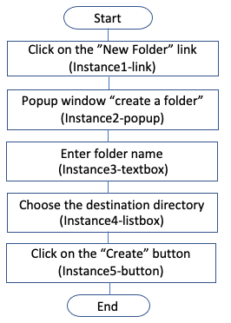
Identifying high-level workflow
Identifying design elements
Identifying potential user errors
Identifying potential security consequences
Identifying interface design triggers

Slide 5
Identifying high-level workflow
Identifying design elements
Identifying potential user errors
Identifying potential security consequences
Identifying interface design triggers
Identify all of the interface components involved in the chosen workflows.
This includes every element where users provide input, navigate or perform activities.
The UISA handbook contains a general list of these design elements.

Slide 6
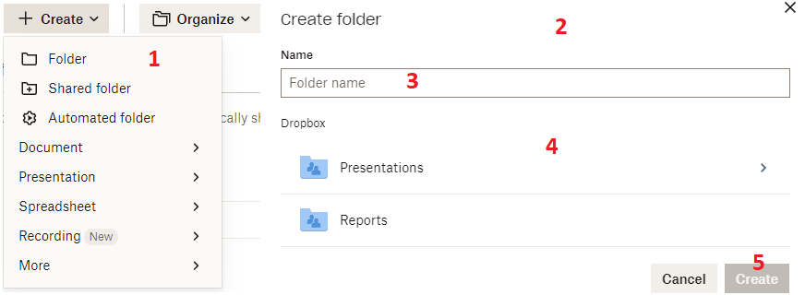
Identifying high-level workflow
Identifying design elements
Identifying potential user errors
Identifying potential security consequences
Identifying interface design triggers

Slide 7
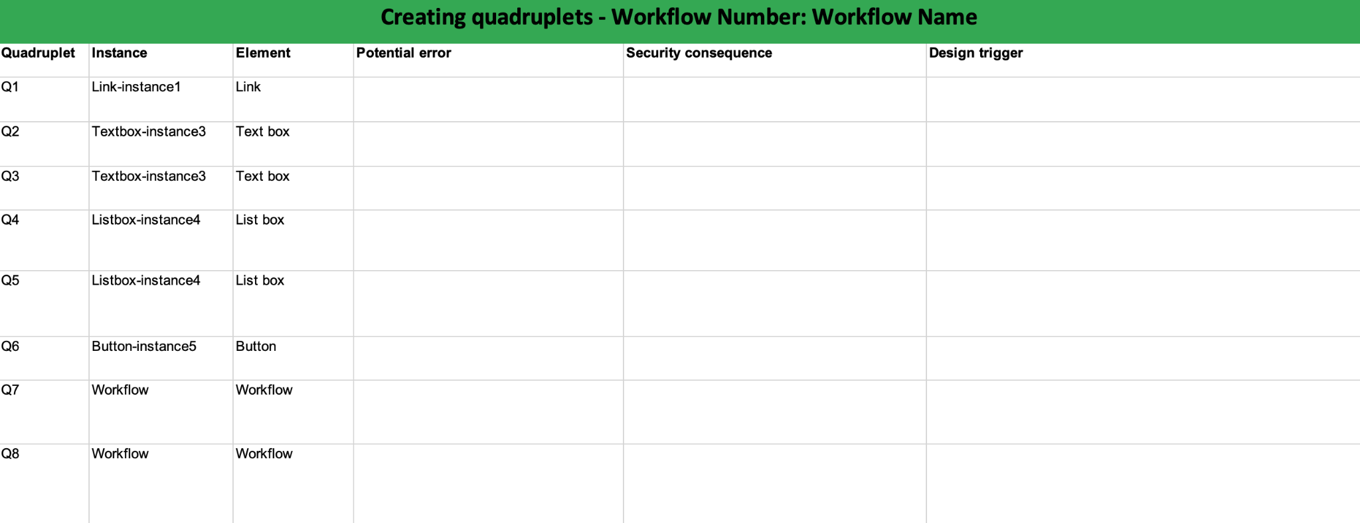
Using the Metric Tool

Slide 8
Identifying high-level workflow
Identifying design elements
Identifying potential user errors
Identifying potential security consequences
Identifying interface design triggers
No possible error should be overlooked during the assessment process.
Consider all kinds of mistakes, from simple unintentional slips to higher level mistakes of finding ways of accomplishing tasks outside of the intended workflow.
The UISA handbook contains a list of possible user errors for each type of interface element and a list of users’ common workflow-level mistakes.

Slide 9
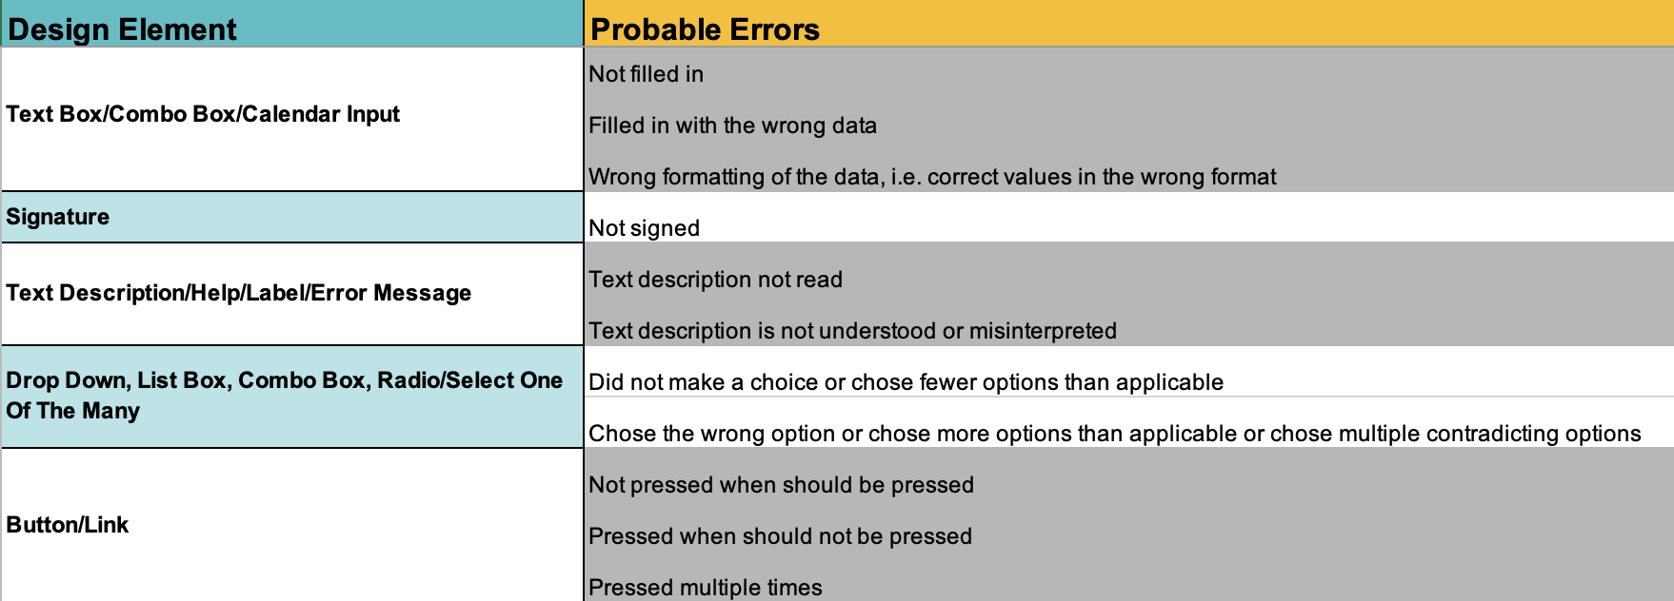
Identifying high-level workflow
Identifying design elements
Identifying potential user errors
Identifying potential security consequences
Identifying interface design triggers

Slide 10
Identifying high-level workflow
Identifying design elements
Identifying potential user errors
Identifying potential security consequences
Identifying interface design triggers

Slide 11
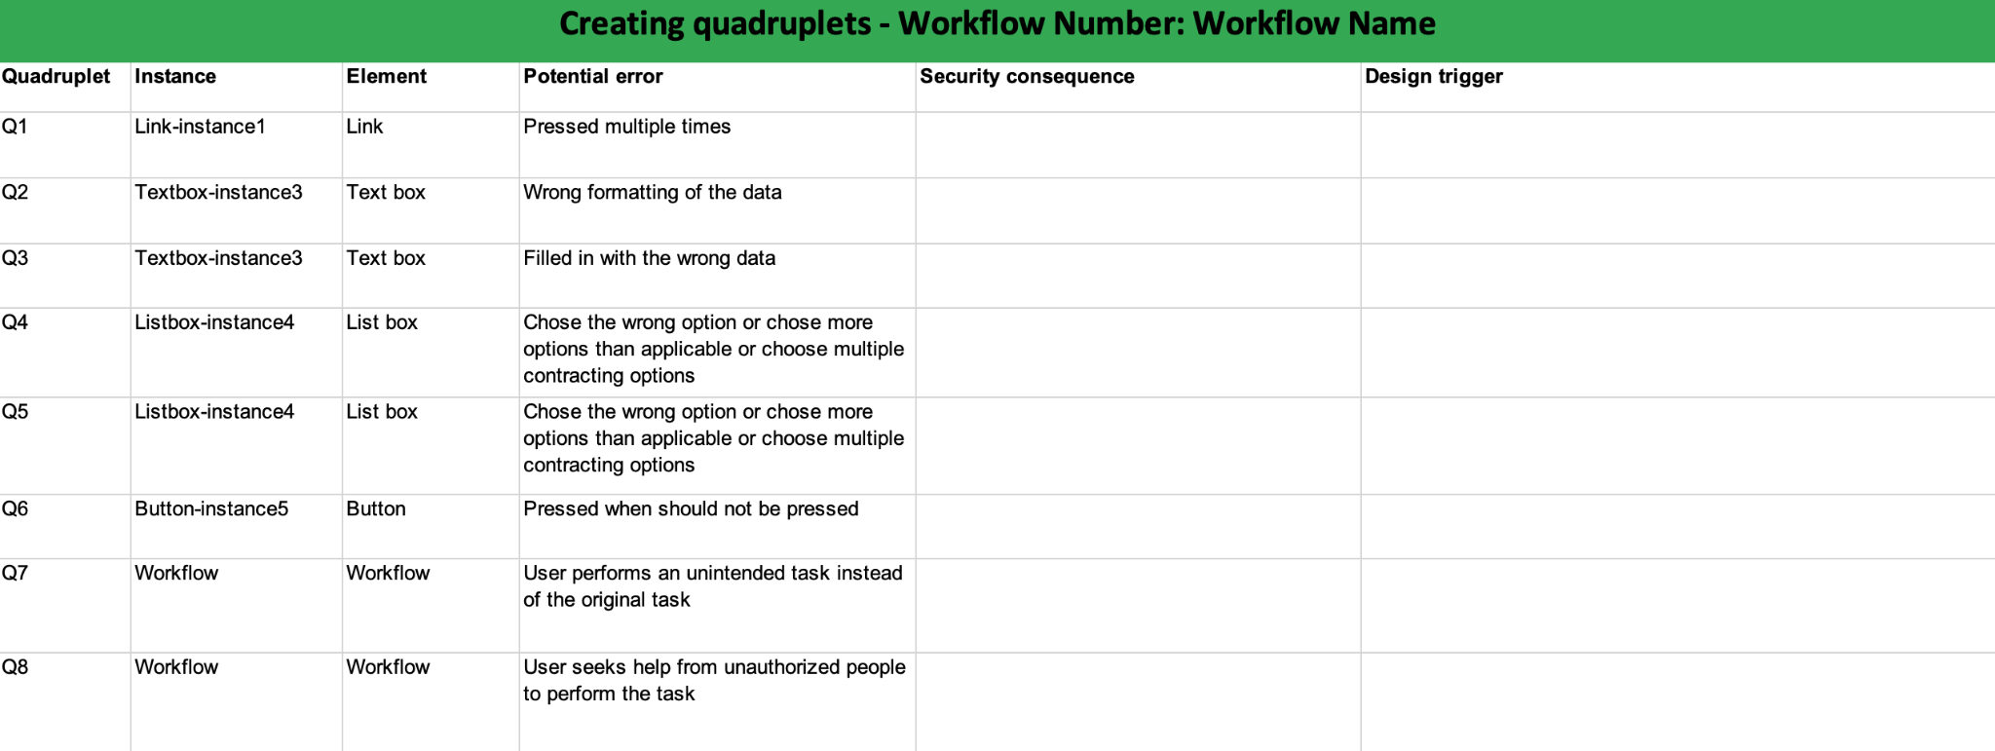
Using the Metric Tool

Slide 12
Identifying high-level workflow
Identifying design elements
Identifying potential user errors
Identifying potential security consequences
Identifying interface design triggers
The handbook contains a set of questions to ask for both element-level and workflow-level errors.
If the answer to any of those questions is positive, then you should describe the security related implication in your own words to make the implication concrete for the particular application.

Slide 13
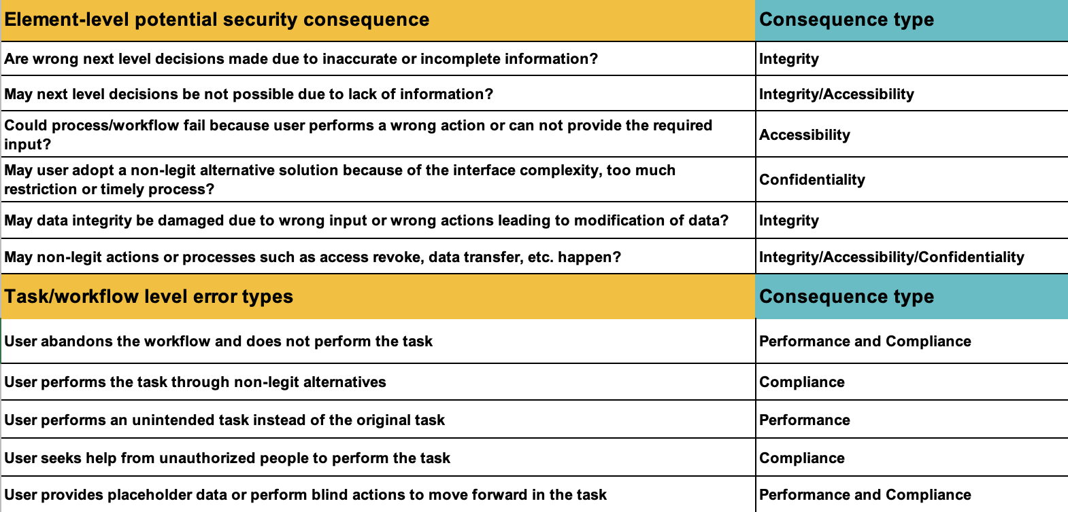
Identifying high-level workflow
Identifying design elements
Identifying potential user errors
Identifying potential security consequences
Identifying interface design triggers

Slide 14
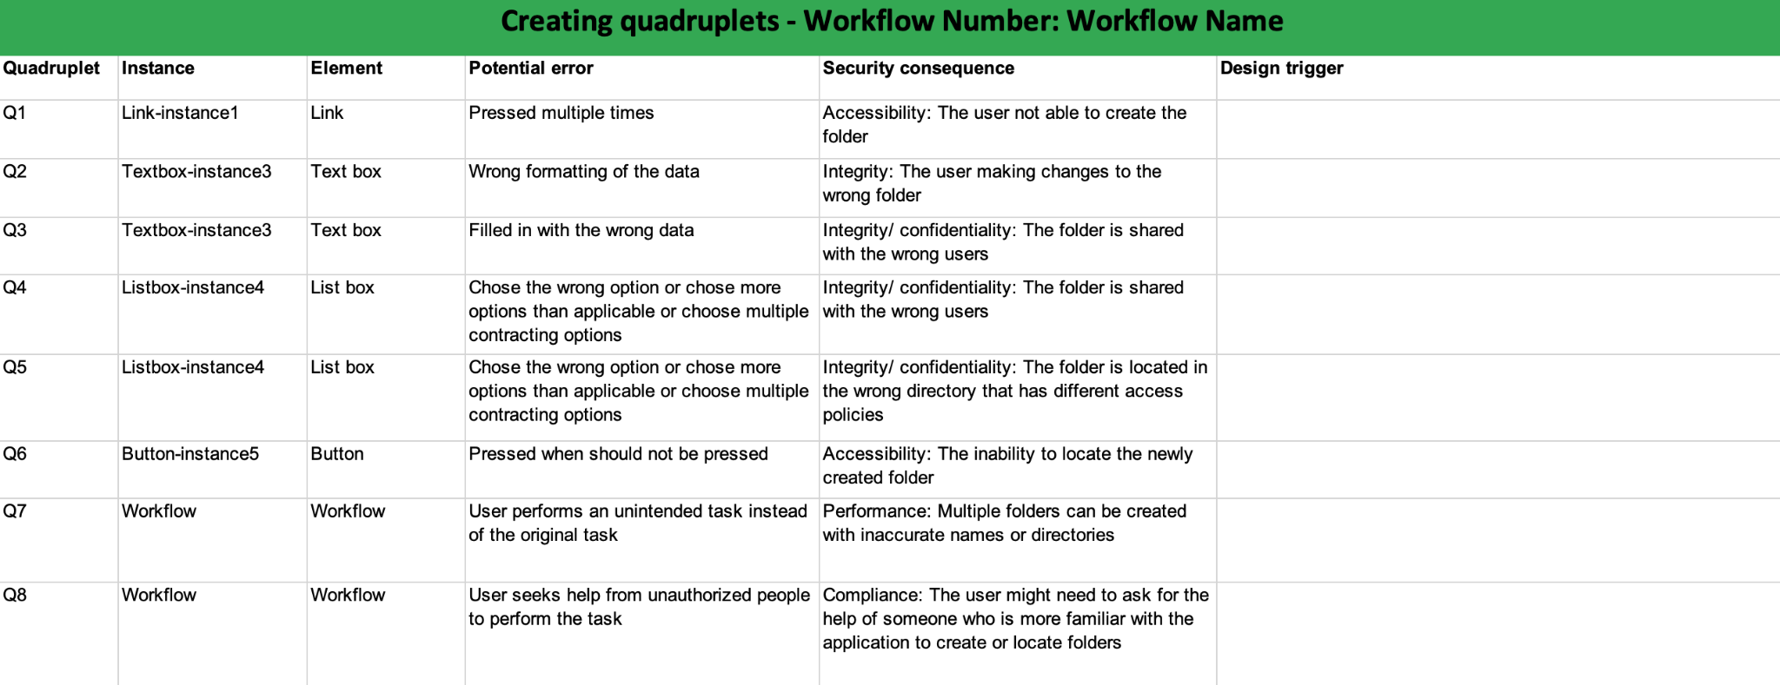
Using the Metric Tool

Slide 15
Identifying high-level workflow
Identifying design elements
Identifying potential user errors
Identifying potential security consequences
Identifying interface design triggers
Design triggers are underlying design choices that might increase the likelihood of the identified errors occurring.
Each element or workflow can have one design trigger or multiple design triggers.
The handbook contains a list of possible design triggers for each design element or workflow.

Slide 16
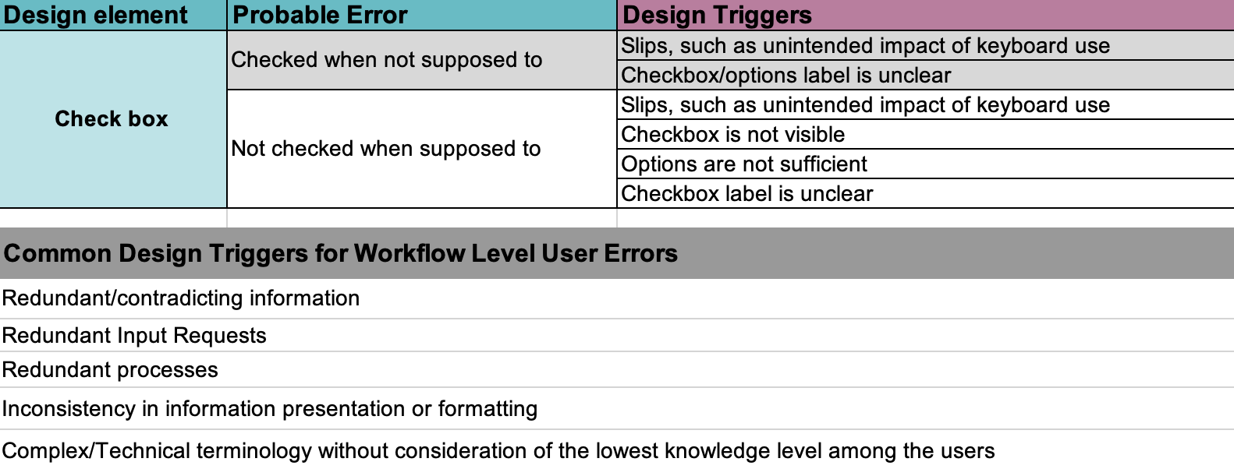
Identifying high-level workflow
Identifying design elements
Identifying potential user errors
Identifying potential security consequences
Identifying interface design triggers

Slide 17
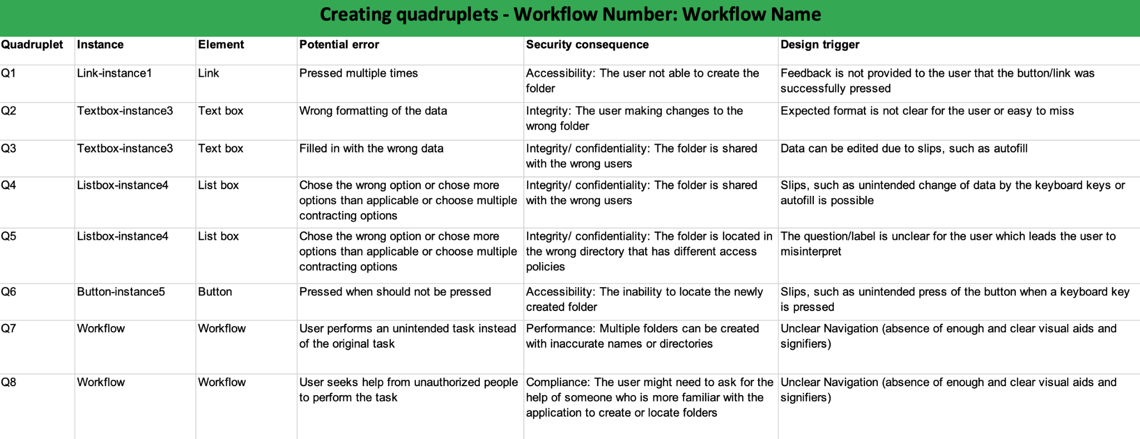
Using the Metric Tool

Slide 18
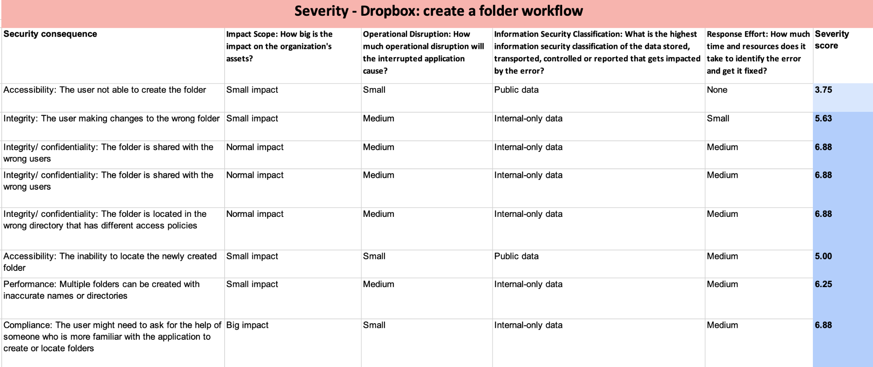
Severity

Slide 19
Using the Metric Tool

Slide 20
Using the Metric Tool

Slide 21
Security Score

